Slide 1
18-758 Final project review
Team name:
Daire2compaire
Team members:
Raewyn Duvall
Emmanuel Aire-Oaihimire

Slide 2
Basic design

Slide 3
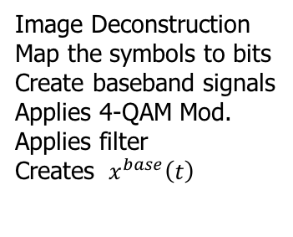
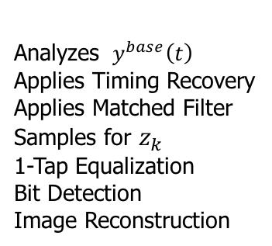
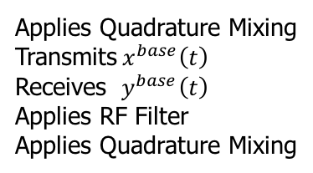
PLEASE STAND BY FOR MATLAB PLOTS
Image Deconstruction
Map the symbols to bits
Create baseband signals
Applies 4-QAM Mod.
Applies filter
Creates ${ x}^{base}\left(t\right)$
Applies Quadrature Mixing
Transmits${ x}^{base}\left(t\right)$
Receives ${ y}^{base}\left(t\right)$
Applies RF Filter
Applies Quadrature Mixing
Analyzes ${ y}^{base}\left(t\right)$
Applies Timing Recovery
Applies Matched Filter
Samples for $z_{k}$
1-Tap Equalization
Bit Detection
Image Reconstruction

Slide 4
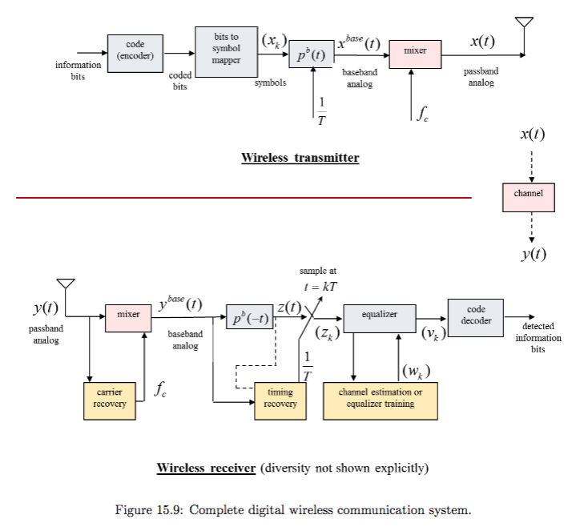
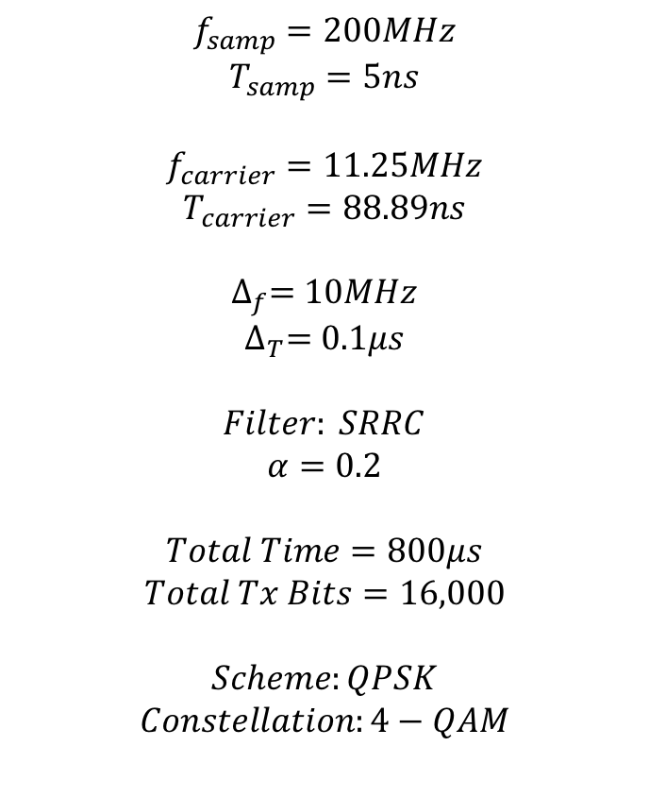
Basic Transceiver Design
$$f_{samp}=200MHz$$
$$T_{samp}=5ns$$
$$f_{carrier}=11.25MHz$$
$$T_{carrier}=88.89ns$$
$$∆_{f}=10MHz$$
$$∆_{T}=0.1μs$$
$$Filter: SRRC$$
$$α=0.2$$
$$Total Time=800μs$$
$$Total Tx Bits=16,000$$
$$Scheme:QPSK$$
$$Constellation:4−QAM$$

Slide 5

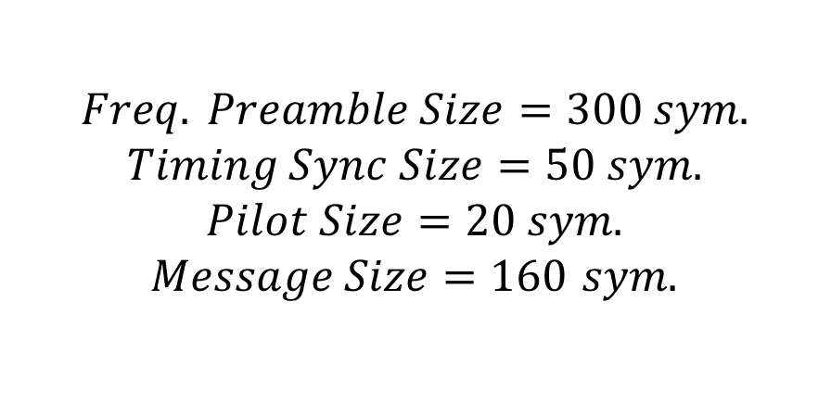
Basic design discussion
What are we sending?
Frequency Preamble
Timing Sync
Pilot
Message
Pilot
Message
Pilot
…
Message
Pilot
$$Freq. Preamble Size=300 sym.$$
$$Timing Sync Size=50 sym.$$
$$Pilot Size=20 sym.$$
$Message Size=160$ $sym.$

Slide 6
Advanced design

Slide 7
Advanced design motivation
What is your chosen advanced design?
Spread Spectrum
Rake receiver with 3 fingers
How this advanced design solves some identified problem
Anti-jamming
Multiple user random access communications with selective addressing capability

Slide 8

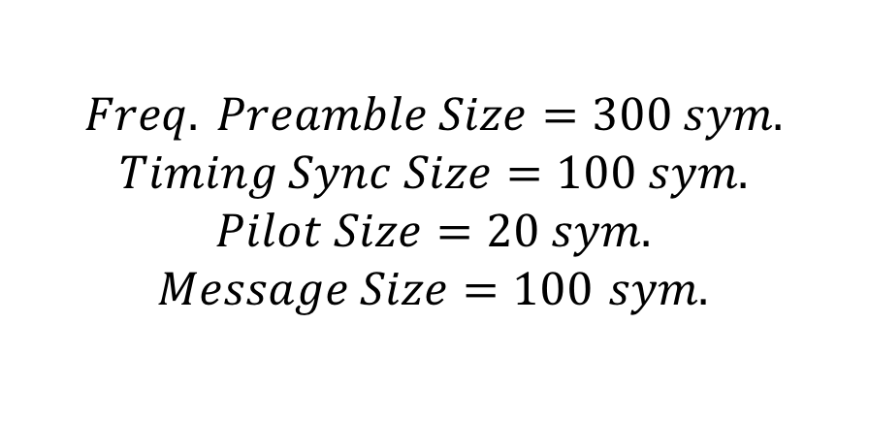
Advanced design discussion
What are we sending?
”OH HI YA!”
Frequency Preamble
Timing Sync
Pilot
Message
Pilot
Message
Pilot
…
Message
Pilot
$$Freq. Preamble Size=300 sym.$$
$$Timing Sync Size=100 sym.$$
$$Pilot Size=20 sym.$$
$Message Size=100$ $sym.$

Slide 9
Advanced design idea
Adder
…
Decoded Bits

Slide 10
Advanced design in USRP project
Repeat 3 times
Image Deconstruction
Map the symbols to bits
Create baseband signals
Applies 4-QAM Mod.
Applies filter
Creates ${ x}^{base}\left(t\right)$
Analyzes ${ y}^{base}\left(t\right)$
Applies Timing Recovery
Applies Matched Filter
Samples for $z_{k}$
1-Tap Equalization
Bit Detection
Image Reconstruction

Slide 11
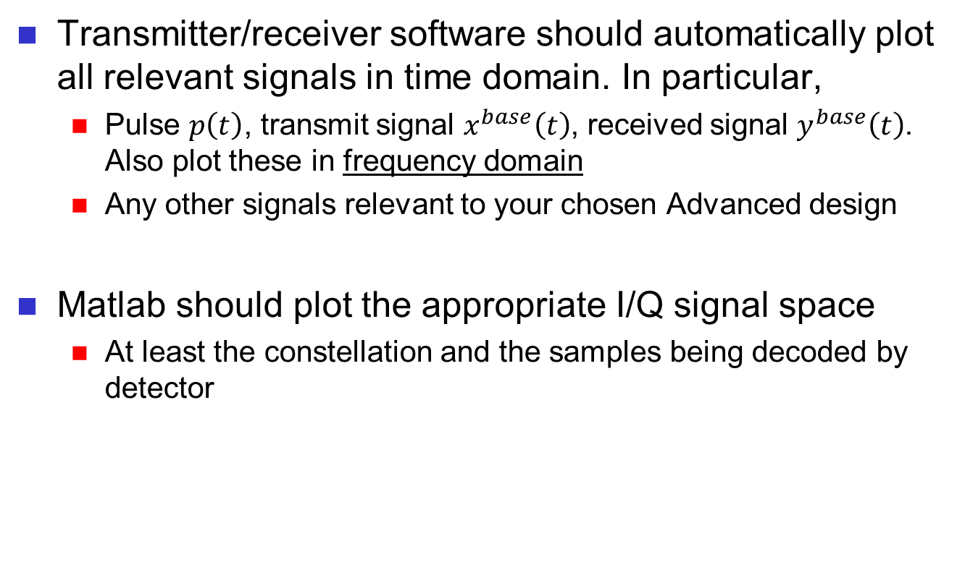
Advanced design demo (Matlab plots these during class demo)
Transmitter/receiver software should automatically plot all relevant signals in time domain. In particular,
Pulse $p\left(t\right)$, transmit signal $x^{base}\left(t\right)$, received signal $y^{base}\left(t\right)$. Also plot these in frequency domain
Any other signals relevant to your chosen Advanced design
Matlab should plot the appropriate I/Q signal space
At least the constellation and the samples being decoded by detector

Slide 12
Citations
R. Pickholtz, D. Schilling and L. Milstein, “Theory of Spread-Spectrum Commu-nications - A Tutorial,” IEEE Transactions on Communications. vol. 30, May 1982.
Ziemer, R. E.; Tranter, W. H. (August 2001). Principles of Communications: Systems, Modulation, and Noise, 5th Edition. Wiley. ISBN 978-0-471-39253-8.
http://www.wirelesscommunication.nl/reference/chaptr05/cdma/rake.htm

